Slide 1
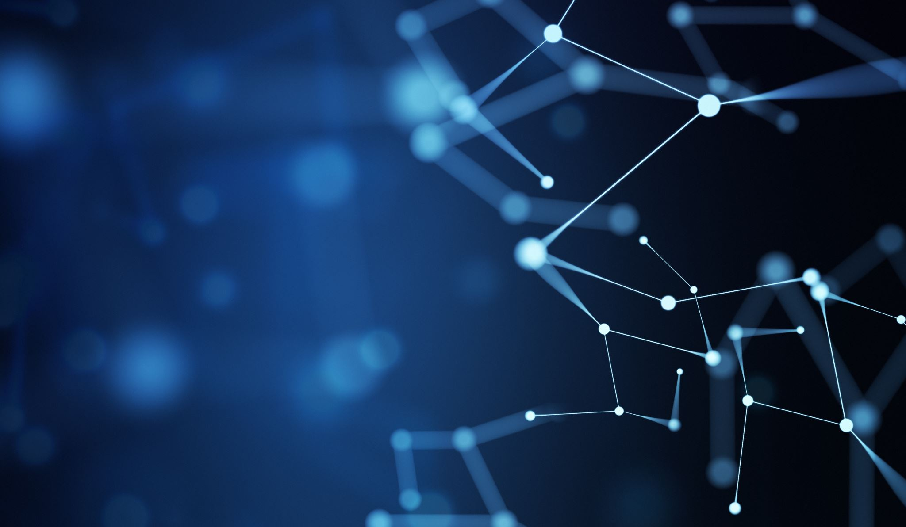
Potential Role of Nanoparticles in Pain Treatment
Jess Hoynoski

Slide 2
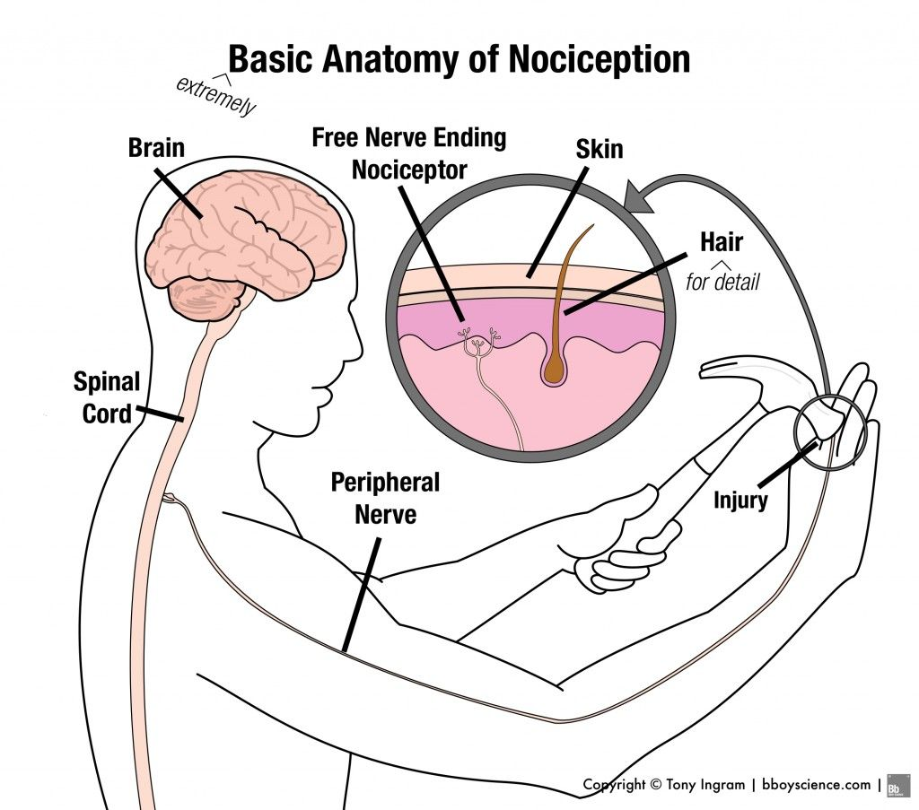
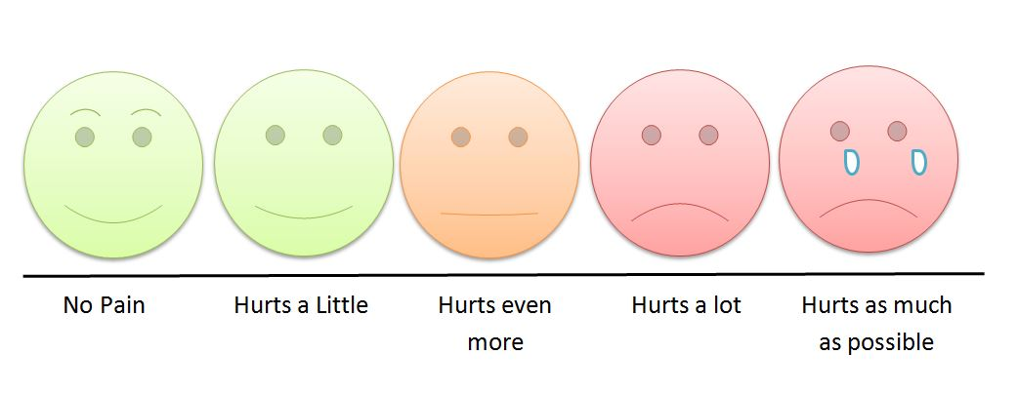
Terminology (IASP)
Pain: An unpleasant sensory and emotional experience associated with actual or potential tissue damage, or described in terms of such damage
Nociception: The neural process of encoding noxious stimuli
https://opentextbc.ca/clinicalskills/chapter/2-1-1-focused-pain-assessment/

Slide 3
General Information on Pain
Affects more Americans than diabetes, heart disease and cancer combined
Most common cause of long-term disability
Can be a chronic disease and comorbid with other diseases and conditions
(e.g. depression, post-traumatic stress disorder, traumatic brain injury)
https://report.nih.gov/nihfactsheets/ViewFactSheet.aspx?csid=57; (Treede et al. Pain. 2015, 156(6): 1003)

Slide 4
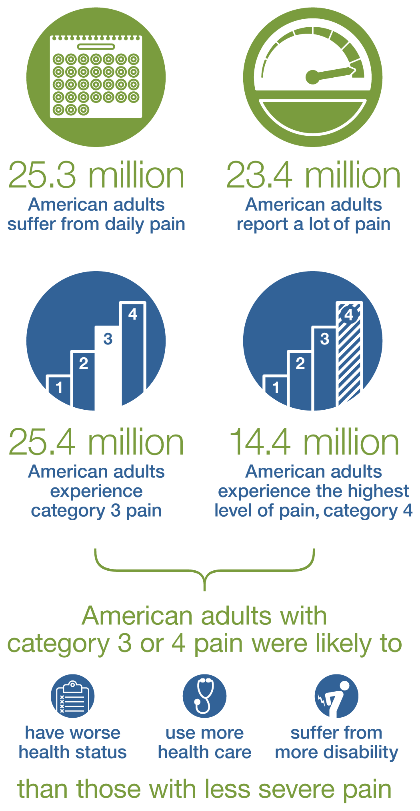
2012 National Health Interview Survey
https://nccih.nih.gov/research/statistics/NHIS/2012/pain/severity

Slide 5
Pain Treatments - NSAIDS
Nonsteroidal anti-inflammatory drugs (NSAIDs)
Inhibit cyclooxygenase 2 (COX-2) enzymes
Prevents the production of prostaglandins (PGs)
Inflammation
Pain
Fever
Able to treat mild to moderate pain
Well-tolerated
Potential gastrointestinal and cardiovascular side effects
https://www.webmd.com/arthritis/features/making-decision-on-nsaids#1

Slide 6
Pain Treatments – Opioids
Ex. Morphine, hydrocodone, and oxycodone
Works through G-protein coupled receptors; reduces neural activity via
Prevent Ca²⁺ influx in the presynaptic cell
Promote K⁺ efflux in the pre- and postsynaptic cell
Reduces neuronal activity in pain circuitry, but also in other areas such as the respiratory system
Activated by endogenous peptides such as enkephalins, dynorphins, and endorphins
Used to treat severe pain
Highly addictive
Numerous side effects
Duarte & Raphael 2014
Notes:
Mimicking NP NTs, reduce overall neural activity in pain pathways
Side effects: sedation, dizziness, nausea, vomiting, constipation, physical dependence, tolerance, and respiratory depression

Slide 7
Pain Treatments - Other
Mind-body techniques
Meditation
Progressive muscle relaxation
Breathing exercises
Biofeedback
Acupuncture
Massage
Cold laser therapy
Cognitive behavioral therapy (CBT)
https://www.health.harvard.edu/staying-healthy/non-opioid-options-for-managing-chronic-pain

Slide 8
Current State on Pain
Continue to treat pain with opioids and NSAIDs
Little to no understanding on how other pain treatments work
More effective treatment options for pain management

Slide 9
Synergism between gabapentin–tramadol in experimental diabetic neuropathic pain
Hugo F. Miranda , Fernando Sierralta , Nicolas Aranda, Paula Poblete , Viviana Noriega , Juan C. Prieto
2018

Slide 10
Gabapentin and Tramadol
Gabapentin
Anticonvulsant
Alpha 2-delta subunit Ca²⁺ voltage-gated channel blocker
Tramadol
Opioid pain reliever
Activates mu opioid receptor

Slide 11
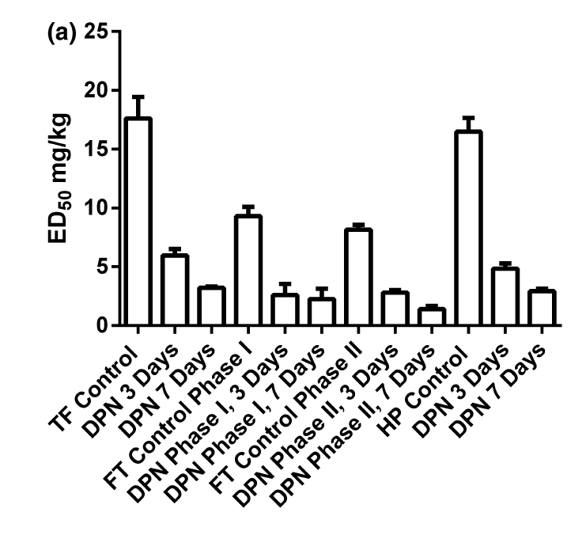
Gabapentin: - increased reaction times (TF) - reduced licking time (FT) - increased latency (HT) Tramadol shows similar trends
Diabetic peripheral neuropathy (DPN), formalin test (FT), hot plate test (HP), tail flick (TF)
Notes:
Formalin test: phase-1 activity was prominent in A beta and A delta fibers as well as in high-threshold C nociceptive afferent fibers. Phase-2 activity was observed in A delta fibers with receptive fields in hairy skin and in all mechanically sensitive C fibers.

Slide 12
Main take away message:
Anticonvulsant medications like gabapentin may be more effective than some opioids for treating pain

Slide 13
Protein-Functionalized PLGA Nanoparticles of Lamotrigine for Neuropathic Pain Management
Jigar Lalani, Sushilkumar Patil, Atul Kolate, Riddhi Lalani, and Ambikanandan Misra
2015

Slide 14
Background
Lamotrigine
Anticonvulsant
Selective Na⁺ and Ca²⁺ channel blocker
How to increase drug delivery across the BBB?
Exploit the presence of active transport mechanisms for supply of nutrients and ions to the brain
The ion transport generally occurs via receptor-mediated endocytosis of non-heme iron-binding glycoproteins
Transferrin (Tf)
Lactotransferrin (Lf)
Melanotransferrin
Notes:
Tf is of particular interest because of substantial expression of Tf receptors on brain capillaries. On the other hand, though Lf has been demonstrated to cross the BBB via receptor-mediated transcytosis, there are very few studies signifying the potential of Lf as brain delivery vector.

Slide 15
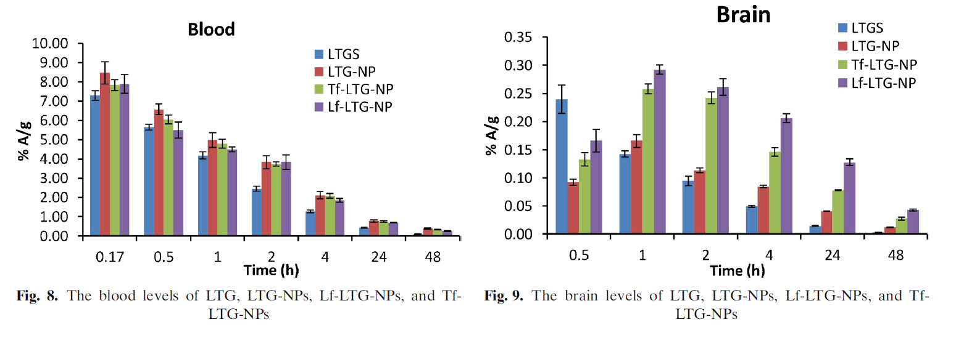
Blood and brain levels of LTG and LTG-loaded NPs
Notes:
LTG displays biphasic plasma behavior and undergoes initial distribution phase followed by prolonged elimination phase which is in congruent with the previous reports

Slide 16
Fig. 10: Organ Distribution

Slide 17
Fig. 10: Organ Distribution

Slide 18
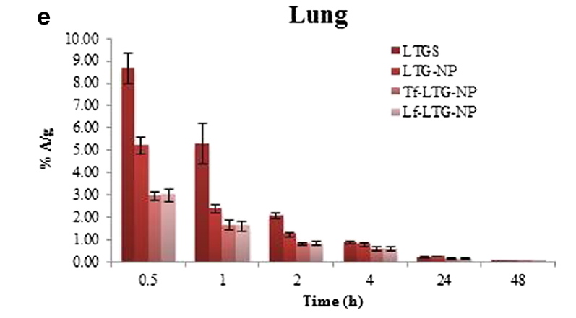
Fig. 10: Organ Distribution

Slide 19
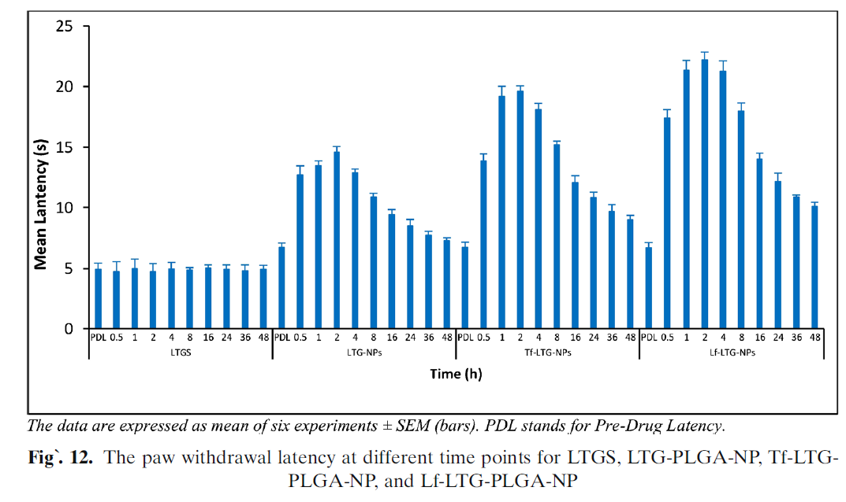

Slide 20
Conclusions
Lf and Tf improve the poor pharmacokinetic profile of LTG
Improves achieve brain targeting
Better retention
Sustained release
Lf superior to Tf for neural targeting after intravenous administration
LTG within the NPs ensures minimum exposure to free drug
Reduces the chances of experiencing side effects
Notes:
Lf superior to Tf: The low endogenous concentration, cationic charge, and unidirectional transport in case of Lf could be major reasons for enhanced uptake of Lf-conjugated nanoparticles in the brain when compared against Tf-conjugated nanoparticles

Slide 21
Locating the Site of Neuropathic Pain In Vivo Using MMP-12- Targeted Magnetic Nanoparticles
Syeda Fabeha Husain, Raymond W. M. Lam, Tao Hu, Michael W. F. Ng,
Z. Q. G. Liau, Keiji Nagata, Sanjay Khanna, Yulin Lam, Kishore Bhakoo,
Roger C. M. Ho, and Hee-Kit Wong
2019

Slide 22
Background
Matrix metalloproteinases (MMP), but specifically MMP-12, is increased during peripheral inflammation
MMP-12-targeted magnetic iron oxide nanoparticle (IONP)

Slide 23
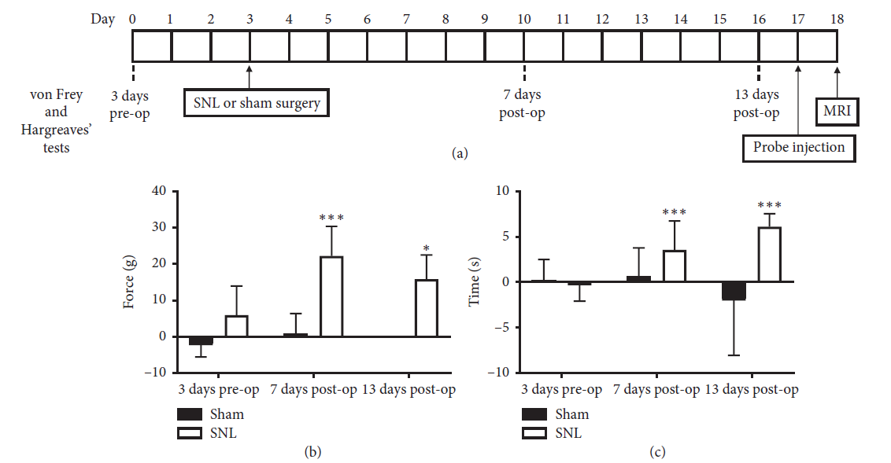

Slide 24
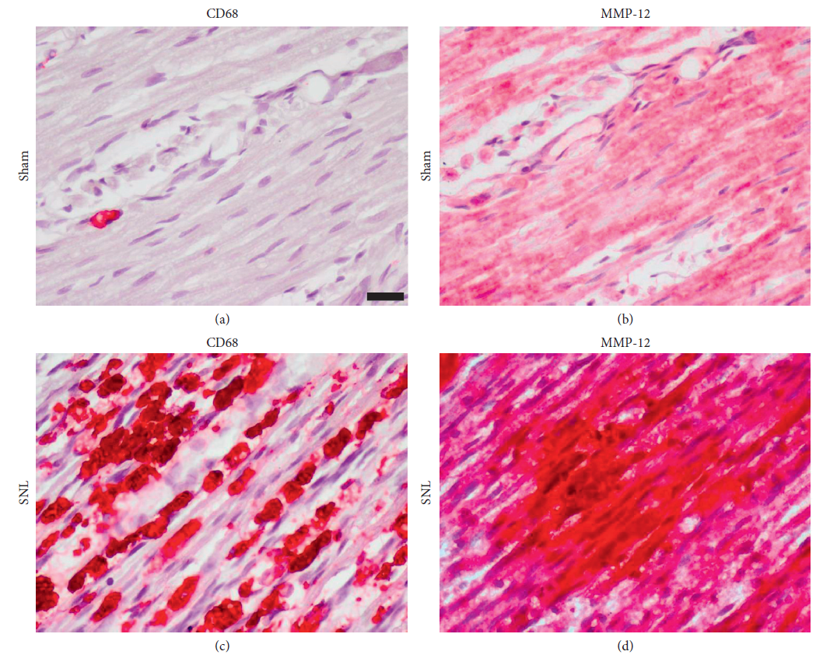
Macrophage infiltration and MMP-12 upregulation occurred in injured nerves

Slide 25
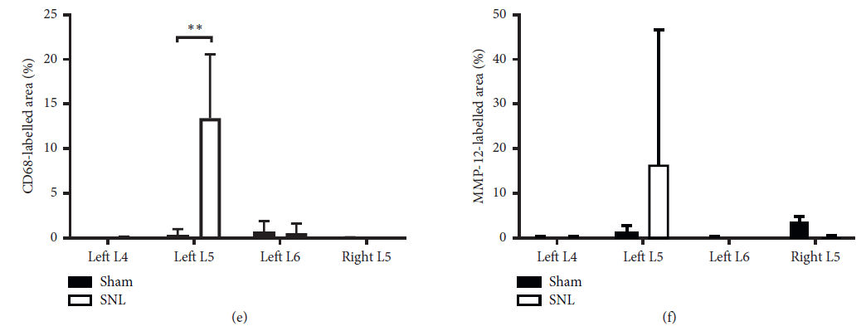
Macrophage infiltration and MMP-12 upregulation occurred in injured nerves

Slide 26
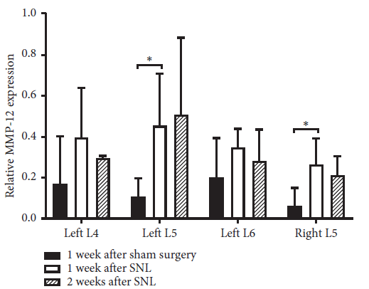
MMP-12 upregulation in ligated left L5 spinal nerve is observed for up to 2 weeks

Slide 27
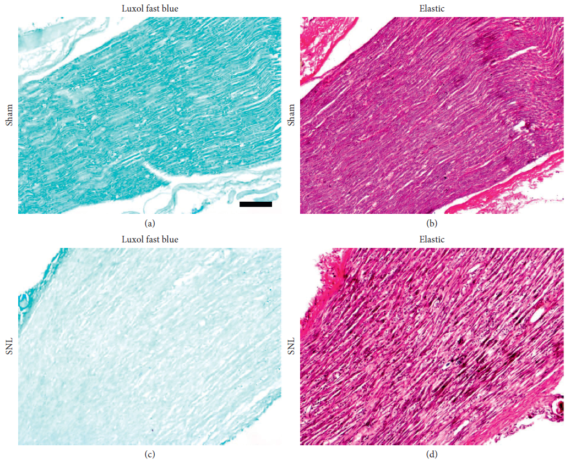
Demyelination and elastin fiber loss occurred at the site of ligation

Slide 28
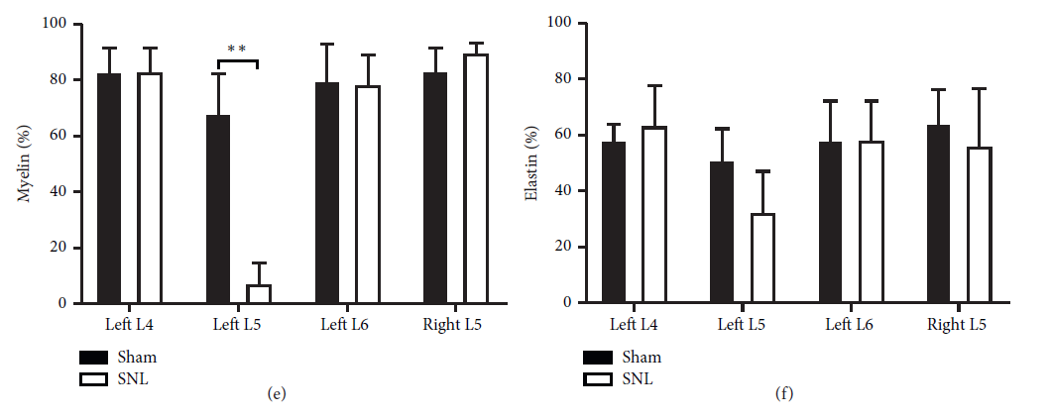
Demyelination and elastin fiber loss occurred at the site of ligation

Slide 29
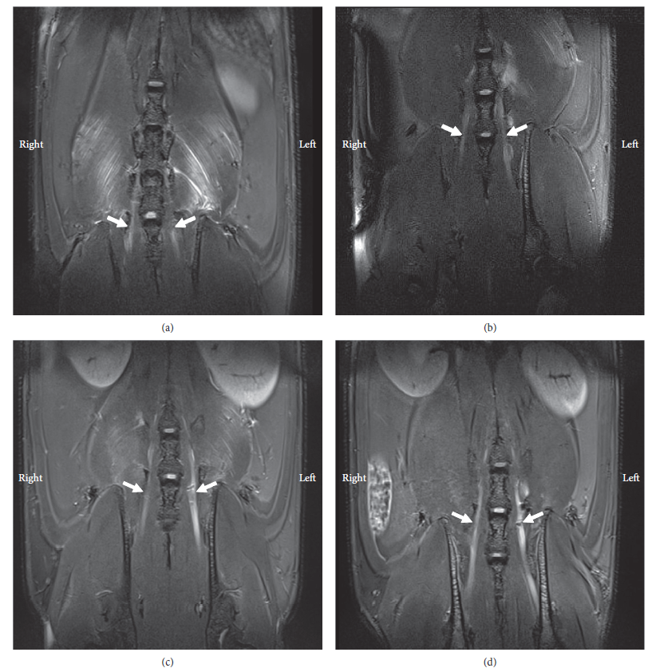
Compared to uninjured nerves, injured nerves are enlarged, and iron-induced signal loss is observed at the approximate site of ligation

Slide 30
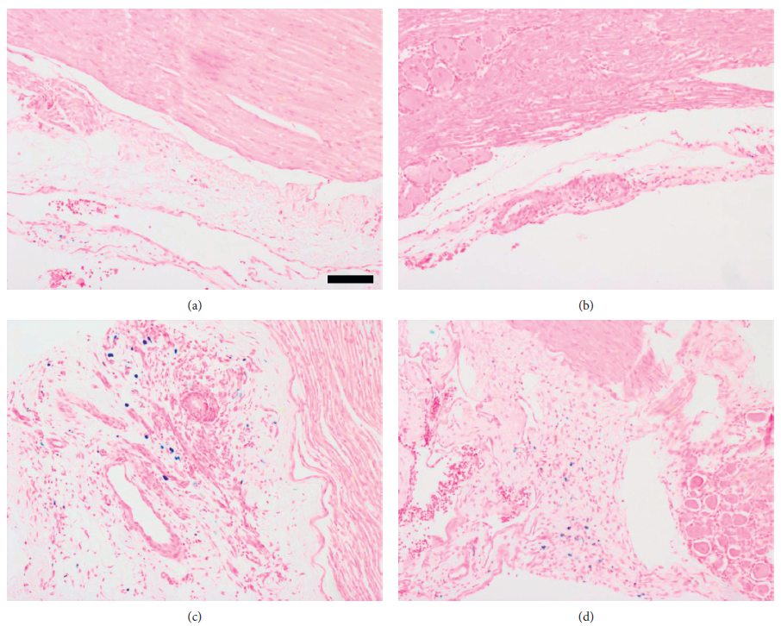
Increased iron staining in the perineural tissues, compared to the corresponding tissues in sham rats

Slide 31
Conclusions
MMP-12 expression is elevated in ligated spinal nerves of neuropathic pain animal model
MMP-12 is a potential target enzyme for IONP-enhanced MRI of injured spinal nerves

Slide 32
Future Directions
Continue studies using nanoparticles to selectively target or treat pain conditions
Combine these studies?

